Slide 1
Parameter Estimation and Control of Multirotors Using Integral Concurrent Learning
Cheng-Cheng Yang and Teng-Hu Cheng
Speaker : Cheng-Cheng Yang
Advisor : Teng-Hu Cheng Associate Professor
Date : 2020/12/24

Slide 2
Outlines
Motivation
Problem Formulation
Controller Design
Stability Analysis
Simulation and Experiments
Conclusion

Slide 3

Motivation – from Walmart’s drone delivery

Slide 4
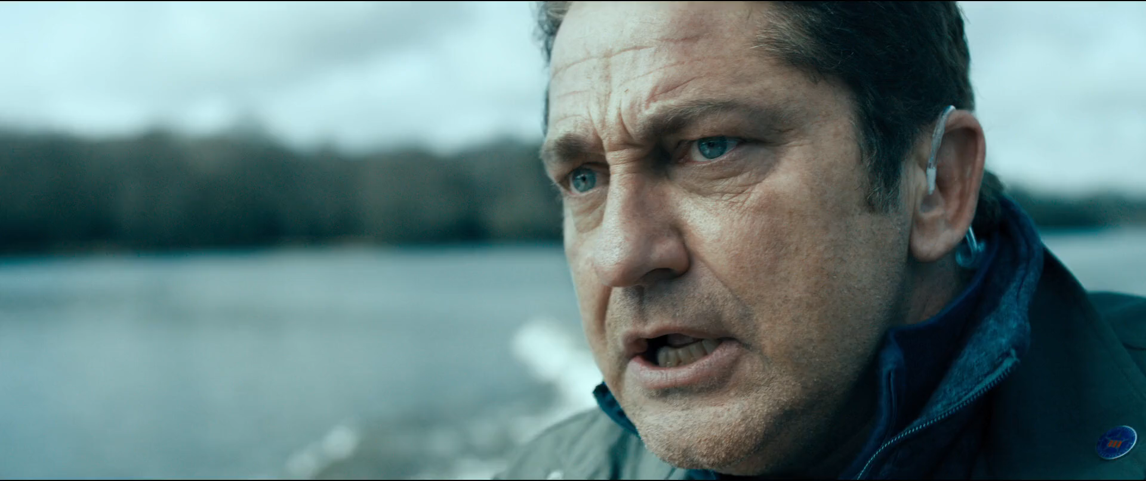
Motivation – from movies Angel Has Fallen

Slide 5
Motivation
Knowledge of the geometric and inertia parameters is essential to achieving good control performance.
The payload or sensors attaching to multirotors may change the geometric and inertia parameters.
Some geometric and inertia parameters like moment of inertia can not be measured through instrument.
Existing adaptive control method can only guarantee the stability of multirotors system, can not ensure the parameters converge.

Slide 6
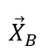
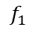
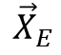
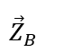
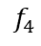
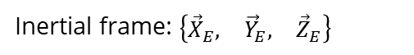
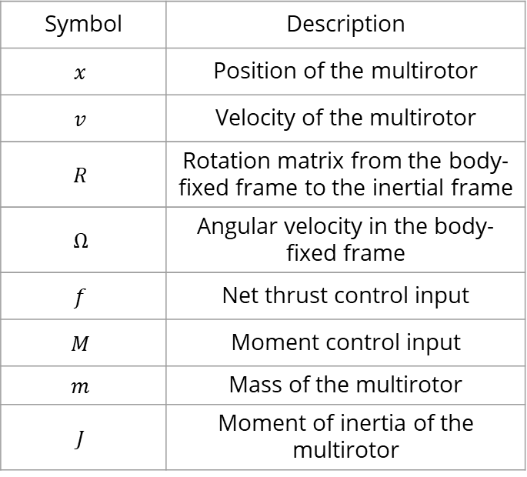
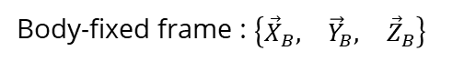
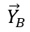

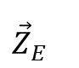
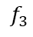
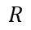
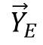
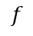
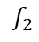
Problem Formulation - Definition of Symbols
Symbol | Description
$$x$$ | Position of the multirotor
$$v$$ | Velocity of the multirotor
$$R$$ | Rotation matrix from the body-fixed frame to the inertial frame
$$Ω$$ | Angular velocity in the body-fixed frame
$$f$$ | Net thrust control input
$$M$$ | Moment control input
$$m$$ | Mass of the multirotor
$$J$$ | Moment of inertia of the multirotor
$$f_{4}$$
$$f_{1}$$
$$f$$
$$f_{3}$$
$${\vec{X}}_{B}$$
$${\vec{Y}}_{B}$$
$$f_{2}$$
$$R$$
$$x$$
$${\vec{Z}}_{B}$$
$${\vec{X}}_{E}$$
$${\vec{Y}}_{E}$$
$${\vec{Z}}_{E}$$
Body-fixed frame : $\left\{\begin{matrix}{\vec{X}}_{B}, & {\vec{Y}}_{B}, & {\vec{Z}}_{B}\end{matrix}\right\}$
Inertial frame: $\left\{\begin{matrix}{\vec{X}}_{E}, & {\vec{Y}}_{E}, & {\vec{Z}}_{E}\end{matrix}\right\}$

Slide 7
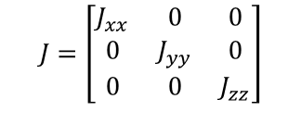


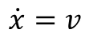

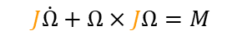
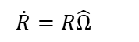
Problem Formulation - Dynamics of the Multirotor
The multirotor is described by both translational and rotational dynamics.
The translational dynamics considers forces such as the effects of gravity, thrusts, and the external force.
The rotational dynamics takes the moment of the control input, rotational speed, and moment of inertia into account.
$$\}$$
$$\dot{x}=v$$
Translational dynamics
$$J=\left[\begin{matrix}J_{xx} & 0 & 0 \\ 0 & J_{yy} & 0 \\ 0 & 0 & J_{zz}\end{matrix}\right]$$
$$m\dot{v}=mge_{3}−fRe_{3}$$
$$\}$$
$$\dot{R}=R\hat{Ω}$$
Rotational dynamics
$$J\dot{Ω}+Ω×JΩ=M$$

Slide 8
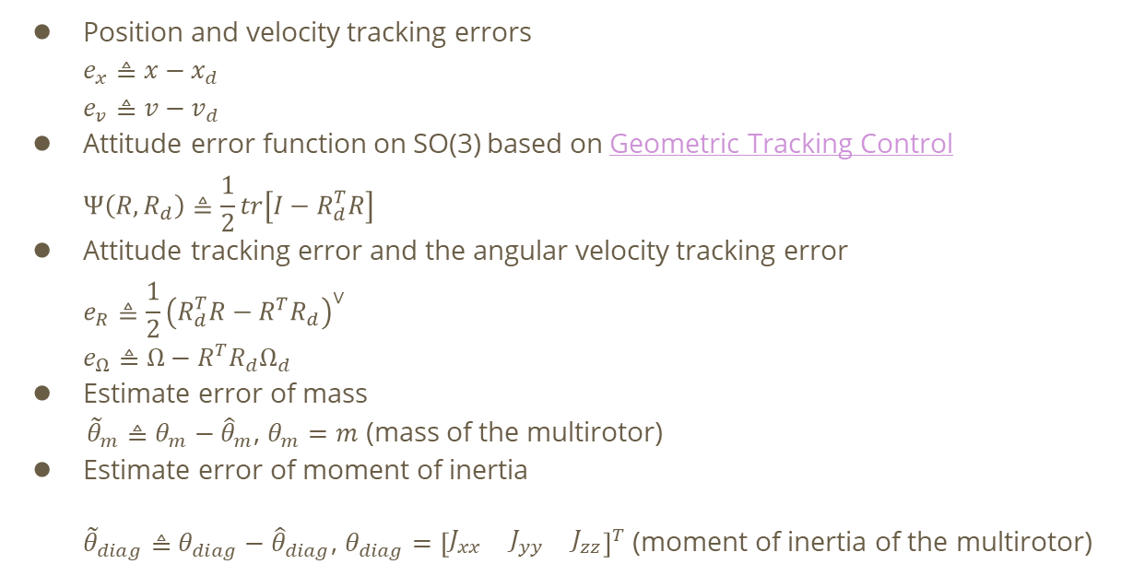
Problem Formulation – Tracking Errors and Estimate Errors
Position and velocity tracking errors
$$e_{x}≜x−x_{d}$$
$$e_{v}≜v−v_{d}$$
Attitude error function on SO(3) based on Geometric Tracking Control
$$Ψ\left(R, R_{d}\right)≜\frac{1}{2}tr\left[I−R_{d}^{T}R\right]$$
Attitude tracking error and the angular velocity tracking error
$$e_{R}≜\frac{1}{2}{\left(R_{d}^{T}R−R^{T}R_{d}\right)}^{∨}$$
$$e_{Ω}≜Ω−R^{T}R_{d}Ω_{d}$$
Estimate error of mass
${\tilde{θ}}_{m}≜θ_{m}−{\hat{θ}}_{m}$, $θ_{m}=m$ (mass of the multirotor)
Estimate error of moment of inertia
${\tilde{θ}}_{diag}≜θ_{diag}−{\hat{θ}}_{diag}$, $θ_{diag}={\left[\begin{matrix}J_{xx} & J_{yy} & J_{zz}\end{matrix}\right]}^{T}$ (moment of inertia of the multirotor)

Slide 9
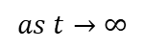
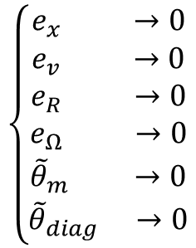
Problem Formulation – Control Objectives
Track a desired 3D trajectory
Track a desired yaw angle
Estimate the mass of the multirotor
Estimate the moment of inertia of the multirotor
$$\left\{\begin{aligned}\begin{matrix}e_{x} & →0\end{matrix} \\ \begin{matrix}e_{v} & →0\end{matrix} \\ \begin{matrix}\begin{matrix}e_{R} & →0\end{matrix} \\ \begin{matrix}e_{Ω} & →0\end{matrix} \\ \begin{matrix}\begin{matrix}{\tilde{θ}}_{m} & →0\end{matrix} \\ \begin{matrix}{\tilde{θ}}_{diag} & →0\end{matrix}\end{matrix}\end{matrix}\end{aligned}\right.$$
$$as t→∞$$
3D position
3D trajectory
yaw angle
desired yaw angle

Slide 10
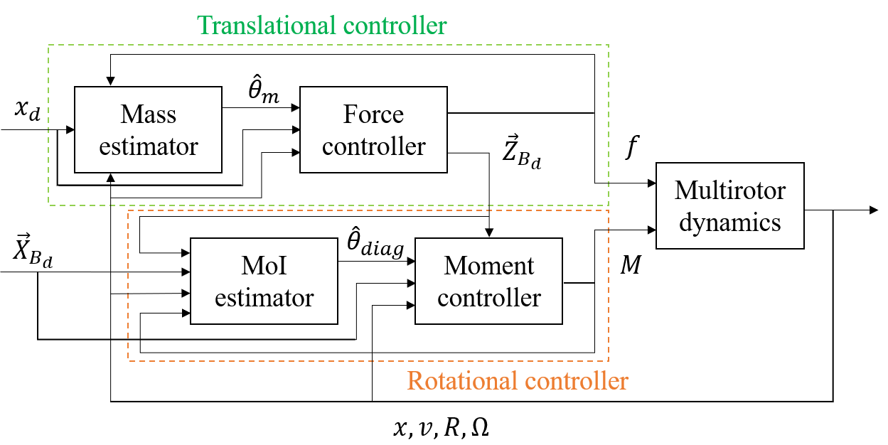
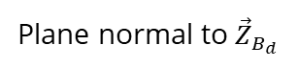
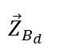
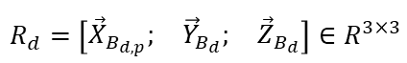
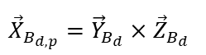
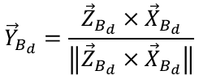
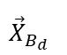
Controller Design – Control Architecture
$${\vec{X}}_{B_{d}}$$
Plane normal to ${\vec{Z}}_{B_{d}}$
$${\vec{X}}_{B_{d,p}}={\vec{Y}}_{B_{d}}×{\vec{Z}}_{B_{d}}$$
$${\vec{Y}}_{B_{d}}=\frac{{\vec{Z}}_{B_{d}}×{\vec{X}}_{B_{d}}}{\left\|{\vec{Z}}_{B_{d}}×{\vec{X}}_{B_{d}}\right\|}$$
$${\vec{Z}}_{B_{d}}$$
$$R_{d}=\left[\begin{matrix}{\vec{X}}_{B_{d,p}}; & {\vec{Y}}_{B_{d}}; & {\vec{Z}}_{B_{d}}\end{matrix}\right]∈R^{3×3}$$

Slide 11
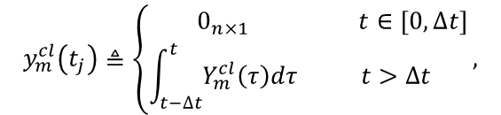
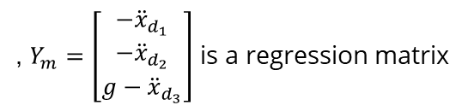

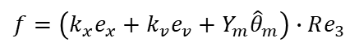
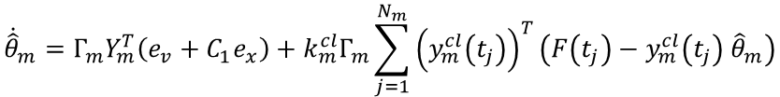


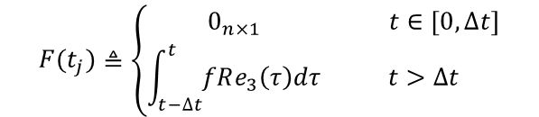
Controller Design – Translational Controller
Translational controller
, $Y_{m}=\left[\begin{matrix}−{\ddot{x}}_{d_{1}} \\ −{\ddot{x}}_{d_{2}} \\ g−{\ddot{x}}_{d_{3}}\end{matrix}\right]$ is a regression matrix
$$f=\left(k_{x}e_{x}+k_{v}e_{v}+Y_{m}{\hat{θ}}_{m}\right)∙Re_{3}$$
$$=feedback term+adaptive term$$
Integral CL-based adaptive control update law ${\dot{\hat{θ}}}_{m}$
$${\dot{\hat{θ}}}_{m}=Γ_{m}Y_{m}^{T}\left(e_{v}+C_{1}e_{x}\right)+k_{m}^{cl}Γ_{m}\sum_{j=1}^{N_{m}}{{\left(y_{m}^{cl}\left(t_{j}\right)\right)}^{T}\left(F\left(t_{j}\right)−y_{m}^{cl}\left(t_{j}\right) {\hat{θ}}_{m}\right)}$$
$$=adaptive term+ICL−based term$$
$$y_{m}^{cl}\left(t_{j}\right)≜\left\{\begin{matrix}0_{n×1} & t∈\left[0,∆t\right] \\ \int_{t−∆t}^{t}{Y_{m}^{cl}\left(τ\right)dτ} & t>∆t\end{matrix}\right.,$$
$$F(t_{j})≜\left\{\begin{matrix}0_{n×1} & t∈\left[0,∆t\right] \\ \int_{t−∆t}^{t}{fRe_{3}\left(τ\right)dτ} & t>∆t\end{matrix}\right.$$

Slide 12
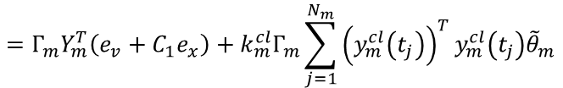
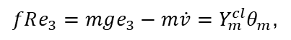
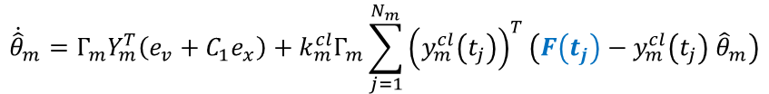



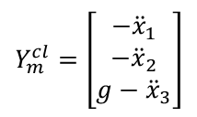

Controller Design – Translational Controller
$Y_{m}^{cl}$ defined as follows contains acceleration terms which is not implementable
$$Y_{m}^{cl}=\left[\begin{matrix}−{\ddot{x}}_{1} \\ −{\ddot{x}}_{2} \\ g−{\ddot{x}}_{3}\end{matrix}\right]$$
$$fRe_{3}=mge_{3}−m\dot{v}=Y_{m}^{cl}θ_{m}\text{,}$$
By integrating $Y_{m}^{cl}$ to be $y_{m}^{cl}$ as defined in last page, $y_{m}^{cl}$ becomes implementable
Integrating both sides of the translational dynamics $fRe_{3}=Y_{m}^{cl}θ_{m}$ yields
$$\int_{t−∆t}^{t}{fRe_{3}}\left(τ\right)dτ=\int_{t−Δt}^{t}{Y_{m}^{cl}\left(τ\right)θ_{m}dτ}⇒\int{fRe_{3}\left(τ\right)}{\left.​\right|}_{τ=t}−\int{fRe_{3}\left(τ\right)}{\left.​\right|}_{τ=t−Δt}=y_{m}^{cl}θ_{m}$$
$${\dot{\hat{θ}}}_{m}=Γ_{m}Y_{m}^{T}\left(e_{v}+C_{1}e_{x}\right)+k_{m}^{cl}Γ_{m}\sum_{j=1}^{N_{m}}{{\left(y_{m}^{cl}\left(t_{j}\right)\right)}^{T}\left(F\left(t_{j}\right)−y_{m}^{cl}\left(t_{j}\right) {\hat{θ}}_{m}\right)}$$
$$=Γ_{m}Y_{m}^{T}\left(e_{v}+C_{1}e_{x}\right)+k_{m}^{cl}Γ_{m}\sum_{j=1}^{N_{m}}{{\left(y_{m}^{cl}\left(t_{j}\right)\right)}^{T}y_{m}^{cl}\left(t_{j}\right){\tilde{θ}}_{m}}$$

Slide 13
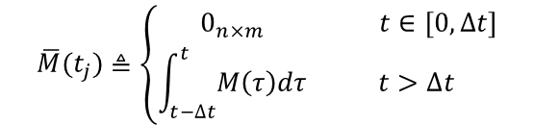
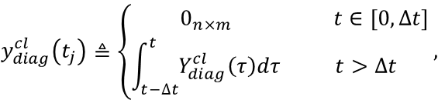
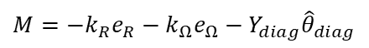


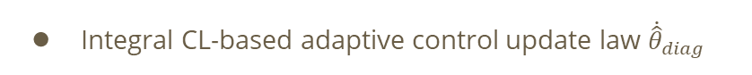
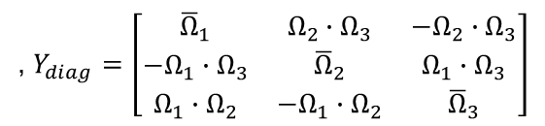
Controller Design – Rotational Controller
Rotational controller
, $Y_{diag}=\left[\begin{matrix}{\overline{Ω}}_{1} & Ω_{2}∙Ω_{3} & −Ω_{2}∙Ω_{3} \\ −Ω_{1}∙Ω_{3} & {\overline{Ω}}_{2} & Ω_{1}∙Ω_{3} \\ Ω_{1}∙Ω_{2} & −Ω_{1}∙Ω_{2} & {\overline{Ω}}_{3}\end{matrix}\right]$
$$M=−k_{R}e_{R}−k_{Ω}e_{Ω}−Y_{diag}{\hat{θ}}_{diag}$$
$$=feedback term+adaptive term$$
Integral CL-based adaptive control update law ${\dot{\hat{θ}}}_{diag}$
$${\dot{\hat{θ}}}_{diag}=Γ_{diag}Y_{diag}^{T}\left(e_{Ω}+C_{2}e_{R}\right)+k_{diag}^{cl}Γ_{diag}\sum_{j=1}^{N}{{\left(y_{diag}^{cl}\left(t_{j}\right)\right)}^{T}\left(\overline{M}\left(t_{j}\right)−y_{diag}^{cl}\left(t_{j}\right) {\hat{θ}}_{diag}\right)}$$
$$=adaptive term+ICL−based term$$
$$y_{diag}^{cl}\left(t_{j}\right)≜\left\{\begin{matrix}0_{n×m} & t∈\left[0,∆t\right] \\ \int_{t−∆t}^{t}{Y_{diag}^{cl}\left(τ\right)dτ} & t>∆t\end{matrix}\right.,$$
$$\overline{M}(t_{j})≜\left\{\begin{matrix}0_{n×m} & t∈\left[0,∆t\right] \\ \int_{t−∆t}^{t}{M\left(τ\right)dτ} & t>∆t\end{matrix}\right.$$

Slide 14
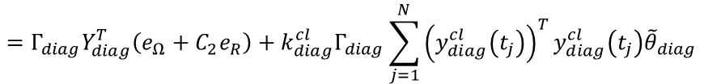
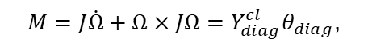




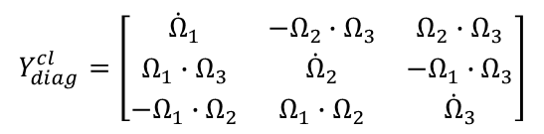

Controller Design – Rotational Controller
$Y_{diag}^{cl}$ defined as follows contains angular acceleration which is not implementable
$$Y_{diag}^{cl}=\left[\begin{matrix}{\dot{Ω}}_{1} & −Ω_{2}∙Ω_{3} & Ω_{2}∙Ω_{3} \\ Ω_{1}∙Ω_{3} & {\dot{Ω}}_{2} & −Ω_{1}∙Ω_{3} \\ −Ω_{1}∙Ω_{2} & Ω_{1}∙Ω_{2} & {\dot{Ω}}_{3}\end{matrix}\right]$$
$$M=J\dot{Ω}+Ω×JΩ=Y_{diag}^{cl}θ_{diag}\text{,}$$
By integrating $Y_{diag}^{cl}$ to be $y_{diag}^{cl}$ as defined in last page, $y_{m}^{cl}$ becomes implementable
Integrating both sides of the translational dynamics $M=Y_{diag}^{cl}θ_{diag}$ yields
$$\int_{t−∆t}^{t}{M}\left(τ\right)dτ=\int_{t−Δt}^{t}{Y_{diag}^{cl}\left(τ\right)θ_{diag}dτ}⇒\int{M\left(τ\right)}{\left.​\right|}_{τ=t}−\int{M\left(τ\right)}{\left.​\right|}_{τ=t−Δt}=y_{diag}^{cl}θ_{diag}$$
$${\dot{\hat{θ}}}_{diag}=Γ_{diag}Y_{diag}^{T}\left(e_{Ω}+C_{2}e_{R}\right)+k_{diag}^{cl}Γ_{diag}\sum_{j=1}^{N}{{\left(y_{diag}^{cl}\left(t_{j}\right)\right)}^{T}\left(\overline{M}\left(t_{j}\right)−y_{diag}^{cl}\left(t_{j}\right) {\hat{θ}}_{diag}\right)}$$
$$=Γ_{diag}Y_{diag}^{T}\left(e_{Ω}+C_{2}e_{R}\right)+k_{diag}^{cl}Γ_{diag}\sum_{j=1}^{N}{{\left(y_{diag}^{cl}\left(t_{j}\right)\right)}^{T}y_{diag}^{cl}\left(t_{j}\right){\tilde{θ}}_{diag}}$$

Slide 15
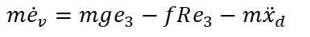
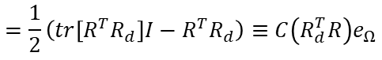









Stability Analysis – Closed-Loop Error Systems
Taking the time derivative of error dynamics $e_{x}$, $e_{v}$ defined in Problem Formulation
$${\dot{e}}_{x}={\dot{e}}_{v}$$
$$m{\dot{e}}_{v}=mge_{3}−fRe_{3}−m{\ddot{x}}_{d}$$
$$=Y_{m}θ_{m}−fRe_{3}$$
$$=−k_{x}e_{x}−k_{v}e_{v}+Y_{m}{\tilde{θ}}_{m}−X$$
, $X=\frac{f}{e_{3}^{T}R_{d}^{T}Re_{3}}\left(\left(e_{3}^{T}R_{d}^{T}Re_{3}\right)Re_{3}−R_{d}e_{3}\right)$
Taking the time derivative of error dynamics $e_{R}$, $e_{Ω}$ defined in Problem Formulation
$${\dot{e}}_{R}=\frac{1}{2}{\left(R_{d}^{T}R{\hat{e}}_{Ω}+{\hat{e}}_{Ω}R^{T}R_{d}\right)}^{∨}$$
$$=\frac{1}{2}\left(tr\left[R^{T}R_{d}\right]I−R^{T}R_{d}\right)≡C\left(R_{d}^{T}R\right)e_{Ω}$$
$${J\dot{e}}_{Ω}=J\dot{Ω}+J\left(\hat{Ω}R^{T}R_{d}Ω_{d}−R^{T}R_{d}{\dot{Ω}}_{d}\right)$$
$$=J\dot{Ω}+J\overline{Ω}=M+Y_{diag}θ_{diag}=−k_{R}e_{R}−k_{Ω}e_{Ω}+Y_{diag}{\tilde{θ}}_{diag}$$

Slide 16







Stability Analysis – Translational Dynamics
Let Lyapunov function $V_{1}$ defined as
$$V_{1}=\frac{1}{2}k_{x}e_{x}^{T}e_{x}+\frac{1}{2}me_{v}^{T}e_{v}+C_{1}me_{x}∙e_{v}+\frac{1}{2}{\tilde{θ}}_{m}^{T}Γ_{m}^{−1}{\tilde{θ}}_{m}$$
$V_{1}$ is P.D. and it can be lower and upper bounded by
$$z_{1}^{T}M_{11}z_{1}+\frac{1}{2}{\tilde{θ}}_{m}^{T}Γ_{m}^{−1}{\tilde{θ}}_{m}≤V_{1}≤z_{1}^{T}M_{12}z_{1}+\frac{1}{2}{\tilde{θ}}_{m}^{T}Γ_{m}^{−1}{\tilde{θ}}_{m}$$
$$z_{1}≜{\left[\begin{matrix}\left\|e_{x}\right\|, & \left\|e_{v}\right\|\end{matrix}\right]}^{T}$$
$$M_{11}=\frac{1}{2}\left[\begin{matrix}k_{x} & −C_{1}m \\ −C_{1}m & m\end{matrix}\right]$$
$$M_{12}=\frac{1}{2}\left[\begin{matrix}k_{x} & C_{1}m \\ C_{1}m & m\end{matrix}\right]$$

Slide 17








Stability Analysis – Translational Dynamics
Taking the time derivative of $V_{1}$ yields
$${\dot{V}}_{1}=k_{x}e_{x}∙{\dot{e}}_{x}+e_{v}∙m{\dot{e}}_{v}+C_{1}m{\dot{e}}_{x}∙e_{v}+C_{1}e_{x}∙m{\dot{e}}_{v}−{\tilde{θ}}_{m}^{T}Γ_{m}^{−1} {\dot{\hat{θ}}}_{m}$$
Substitute ${\dot{e}}_{x}$ and $m{\dot{e}}_{v}$ defined in the previous page into ${\dot{V}}_{1}$
$${\dot{V}}_{1}≤−z_{1}^{T}W_{1}z_{1}+z_{1}^{T}W_{12}z_{2}−k_{m}^{cl}{\tilde{θ}}_{m}^{T}\left(\sum_{j=1}^{N}{{\left(y_{m}^{cl}\left(t_{j}\right)\right)}^{T}y_{m}^{cl}\left(t_{j}\right)}\right){\tilde{θ}}_{m}$$
$$W_{1}=\left[\begin{matrix}k_{x}C_{1}\left(1−α\right) & −\frac{1}{2}C_{1}k_{v}\left(1+α\right) \\ −\frac{1}{2}C_{1}k_{v}\left(1+α\right) & k_{v}\left(1−α\right)−C_{1}m\end{matrix}\right]\text{,}$$
$$W_{12}=\left[\begin{matrix}k_{x}e_{v,max}+C_{1}B & 0 \\ B & 0\end{matrix}\right]$$
$M_{11}$, $M_{12}$, $W_{1}$ in $V_{1}$ and ${\dot{V}}_{1}$ are positive-definite matrices if $C_{1}$ satisfies
$$C_{1}<min\left\{\sqrt{\frac{k_{x}}{m}}, \frac{k_{v}\left(1−α\right)}{m}, \frac{4k_{x}k_{v}{\left(1−α\right)}^{2}}{k_{v}^{2}{\left(1+α\right)}^{2}+4mk_{x}\left(1−α\right)}\right\}$$

Slide 18







Stability Analysis – Rotational Dynamics
Let Lyapunov function $V_{2}$ defined as
$$V_{2}=\frac{1}{2}e_{Ω}∙Je_{Ω}+k_{R}Ψ\left(R,R_{d}\right)+JC_{2}e_{R}∙e_{Ω}+\frac{1}{2}{\tilde{θ}}_{diag}^{T}Γ_{diag}^{−1}{\tilde{θ}}_{diag}$$
$V_{2}$ is P.D. and it can be lower and upper bounded by
$$z_{2}^{T}M_{21}z_{2}+\frac{1}{2}{\tilde{θ}}_{diag}^{T}Γ_{diag}^{−1}{\tilde{θ}}_{diag}≤V_{2}≤z_{2}^{T}M_{22}z_{2}+\frac{1}{2}{\tilde{θ}}_{diag}^{T}Γ_{diag}^{−1}{\tilde{θ}}_{diag}$$
$$z_{2}≜{\left[\begin{matrix}\left\|e_{R}\right\|, & \left\|e_{Ω}\right\|\end{matrix}\right]}^{T}$$
$$M_{21}=\frac{1}{2}\left[\begin{matrix}k_{R} & −C_{2}λ_{max}\left(J\right) \\ −C_{2}λ_{max}\left(J\right) & λ_{min}\left(J\right)\end{matrix}\right]$$
$$M_{22}=\frac{1}{2}\left[\begin{matrix}\frac{2k_{R}}{2−ψ_{2}} & −C_{2}λ_{max}\left(J\right) \\ −C_{2}λ_{max}\left(J\right) & λ_{min}\left(J\right)\end{matrix}\right]$$

Slide 19







Stability Analysis – Rotational Dynamics
Taking the time derivative of $V_{2}$ yields
$${\dot{V}}_{2}=\left(e_{Ω}+C_{2}e_{R}\right)∙\left(J{\dot{e}}_{Ω}\right)+k_{R}e_{Ω}∙e_{R}+JC_{2}{\dot{e}}_{R}∙e_{Ω}−{\tilde{θ}}_{diag}^{T}Γ_{diag}^{−1} {\dot{\hat{θ}}}_{diag}$$
Substitute ${\dot{e}}_{R}$ and $J{\dot{e}}_{Ω}$ defined in the previous page into ${\dot{V}}_{2}$
$${\dot{V}}_{2}≤−z_{2}^{T}W_{2}z_{2}−k_{diag}^{cl}{\tilde{θ}}_{diag}^{T}\left(\sum_{j=1}^{N}{{\left(y_{diag}^{cl}\left(t_{j}\right)\right)}^{T}y_{diag}^{cl}\left(t_{j}\right)}\right){\tilde{θ}}_{diag}$$
$$W_{2}=\left[\begin{matrix}C_{2}k_{R} & −\frac{C_{2}k_{Ω}}{2} \\ −\frac{C_{2}k_{Ω}}{2} & k_{Ω}−C_{2}λ_{max}\left(J\right)\end{matrix}\right]$$
$M_{21}$, $M_{22}$, $W_{2}$ in $V_{2}$ and ${\dot{V}}_{2}$ are positive-definite matrices if $C_{2}$ satisfies
$$C_{2}<min\left\{\frac{k_{Ω}}{λ_{max}\left(J\right)},\frac{4k_{Ω}k_{R}}{k_{Ω}^{2}+4k_{R}λ_{max}\left(J\right)},\sqrt{\frac{k_{R}λ_{min}\left(J\right)}{λ_{max}{\left(J\right)}^{2}}}\right\}$$

Slide 20








Stability Analysis – Overall System
Let $V=V_{1}+V_{2}$ be a Lyapunov function for the system containing rotational and translational dynamics
$$V=V_{1}+V_{2}$$
$$=\frac{1}{2}k_{x}e_{x}^{T}e_{x}+\frac{1}{2}me_{v}^{T}e_{v}+C_{1}me_{x}∙e_{v}+\frac{1}{2}{\tilde{θ}}_{m}^{T}Γ_{m}^{−1}{\tilde{θ}}_{m}$$
$$+\frac{1}{2}e_{Ω}∙Je_{Ω}+k_{R}Ψ\left(R,R_{d}\right)+JC_{2}e_{R}∙e_{Ω}+\frac{1}{2}{\tilde{θ}}_{diag}^{T}Γ_{diag}^{−1}{\tilde{θ}}_{diag}$$
… P.D.
Taking the time derivative of $V$ and substituting ${\dot{V}}_{1}$ and ${\dot{V}}_{2}$ yields
$$\dot{V}={\dot{V}}_{1}+{\dot{V}}_{2}≤−z_{1}^{T}W_{1}z_{1}+z_{1}^{T}W_{12}z_{2}−k_{m}^{cl}{\tilde{θ}}_{m}^{T}\left(\sum_{j=1}^{N}{{\left(y_{m}^{cl}\left(t_{j}\right)\right)}^{T}y_{m}^{cl}\left(t_{j}\right)}\right){\tilde{θ}}_{m}$$
$$−z_{2}^{T}W_{2}z_{2}−k_{diag}^{cl}{\tilde{θ}}_{diag}^{T}\left(\sum_{j=1}^{N}{{\left(y_{diag}^{cl}\left(t_{j}\right)\right)}^{T}y_{diag}^{cl}\left(t_{j}\right)}\right){\tilde{θ}}_{diag}$$
… N.D.
, where $λ_{min}\left(W_{2}\right)>{4{\left\|W_{12}\right\|}^{2}}/{λ_{min}\left(W_{1}\right)}$

Slide 21



Simulation – Setup and Ground Truth
A six-rotor multirotor was used as our model in ROS Gazebo
The ground truth of moment of inertia $J$ and $m$ were unknown parameters to be estimated in the simulations, and were used for evaluating the estimate error but not for implementing the controller
Parameter | Value
$$m$$ | 1.568(kg)
$$J$$ | $\left[\begin{matrix}0.035 & 0 & 0 \\ 0 & 0.046 & 0 \\ 0 & 0 & 0.0977\end{matrix}\right]$($kg∙m^{2}$)
$$d$$ | 0.215(m)

Slide 22


Simulation – Translational Error Tracking
The tracking errors of the position and velocity converged asymptotically to zero
The multirotor can track a desired 3D trajectory without the information of mass and moment of inertia

Slide 23


Simulation – Rotational Error Tracking
The tracking errors of the attitude and angular velocity converged asymptotically to zero

Slide 24


Simulation – Estimate Mass and Moment of Inertia
 | Estimation value | Ground truth
Mass | 1.534 | 1.568
Moment of inertia | $$\left[\begin{matrix}0.033 & 0 & 0 \\ 0 & 0.051 & 0 \\ 0 & 0 & 0.091\end{matrix}\right]$$ | $$\left[\begin{matrix}0.035 & 0 & 0 \\ 0 & 0.046 & 0 \\ 0 & 0 & 0.0977\end{matrix}\right]$$
The estimates of the moment of inertia and mass during flight
The normalized estimate errors of the moment of inertia and mass were 7.9% and 1.5%, respectively

Slide 25


Simulation – Adaptive Control v.s. Adaptive ICL Control
The figure above compares the controller performance without and with the ICL controller
This demonstrates the importance and robustness of our developed controller
The figure above compares the estimated parameters when using the adaptive controller and the developed ICL controller
Asymptotic convergence of the estimate errors converged asymptotically when using the ICL controller

Slide 26

Simulation - Video

Slide 27





Experiments – Hardware Architecture
$$M_{2}$$
$$M_{1}$$
2.4 GHz Xbee Module
RC receiver
UBEC
5V to 3V3 switching regulator
OptiTrack marker
900 MHz Xbee Module
Flight control board
$$M_{3}$$
$$M_{4}$$

Slide 28
Experiments - Video
The experiments is based on ncrl-flight-control mainly contributed by Shengwen

Slide 29
Conclusion
An ICL controller has been developed for controlling a multirotor with an unknown mass and moment of inertia
The control architecture can be applied to many types of multirotors of unknown mass, including hexacopters and octocopters
The ICL controller ensures the steady-state errors resulted from the wrong parameters be eliminated
The ICL controller can guarantee asymptotic convergence of the system parameters, while the adaptive controller cannot
Future work can be estimate other parameters of the multirotor, such as off-diagonal elements in the inertia matrix and the center of mass.

Slide 30
Thanks for listening!

